Slide 1
Whistleblowing in the UK: An employment practitioner’s view
ELSA Luxembourg
Caroline Stroud
21 October 2015

Slide 2
Some recent headlines

Slide 3
What is the background to whistleblowing?
Reports into various disasters/scandals
Workers needed to be encouraged to make disclosures in certain situations without fear of reprisals or dismissal
Private Member’s Bill
The Public Interest Disclosure Act 1998 (PIDA)
Came into force on 2 July 1999
Amending legislation which inserts a number of provisions (sections 43A to 43L and section 103A) into the Employment Rights Act 1996 (ERA)

Slide 4
What is whistleblowing?
PCaW definition
Raising a concern about wrongdoing, risk or malpractice with someone in authority either internally and/or externally (ie. regulators, media, government)
Nolan Committee on Standards in Public Life
Raising concerns about misconduct within an organisation or within an independent structure associated with it
Chambers Dictionary
Giving information (usually to the authorities) about illegal or underhand practices

Slide 5
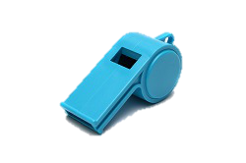
What is whistleblowing? (continued)
In a nutshell, it’s the act of a worker making:
a “protected” disclosure
in the public interest
to a particular person (e.g. their employer)
of danger, malpractice or wrongdoing

Slide 6
Who is protected?
Employees
A wide class of workers including:
anyone engaged under a contract to provide services personally (provided not genuinely in business on their own account)
home workers
self-employed doctors, dentists, opthalmologists and pharmacists in the NHS
agency workers
police officers
those undertaking training or work experience (other than at an educational establishment)
Does not cover the genuinely self-employed

Slide 7
What protection is provided?
It creates two levels of protection for whistleblowers:
protection against dismissal (and selection for redundancy)
protection against being subjected to a detriment

Slide 8
Protection against dismissal (and selection for redundancy) for employees
If the employee can prove that the reason/principal reason for his dismissal was the fact that he blew the whistle, he can bring a claim for unfair dismissal:
Two years qualifying period will not apply
Dismissal will be automatically unfair
Uncapped compensation
Employee must bring a claim within 3 months of the effective date of termination

Slide 9
Protection against detriment for workers
If the worker has been subjected to a detriment on the ground that he has blown the whistle
Detriment is not defined
If a reasonable worker would or might take the view that he had been disadvantaged in the circumstances in which he had to work
Could include:
threats
disciplinary action
loss of work or pay
damage to career prospects
suspension

Slide 10
Protection against detriment for workers (continued)
Claim must be presented “before the end of the period of three months beginning with the date of the act or failure to act to which the complaint relates or, where the act or failure to act is part of a series of similar acts or failures, the last of them”

Slide 11
What are the mechanics?
To qualify for the protection, the disclosure must amount to both:
a qualifying disclosure AND
a protected disclosure

Slide 12
What is a qualifying disclosure??
Actual disclosure of information
Relating to one of six types of “relevant failure”
Reasonable belief that the information tends to show a “relevant failure” is taking place or is likely to take place

Slide 13
What is a qualifying disclosure? (1) Disclosure of information
“Disclosure” is not defined
Worker must actually convey facts
Must be more than an allegation
“The wards have not been cleaned for the past two weeks. Yesterday sharp knives were left lying around”
“You are not complying with health and safety requirements”
Goode v M&S - helps employers identify what does and does not amount to a protected disclosure under the whistleblowing legislation. Cavendish Munro Professional Risks Management Ltd v Geduld - a solicitor's letter that set out a statement of position did not contain a protected disclosure.
Doesn’t matter if those facts are already known to the recipient
Not enough for the worker to have simply gathered evidence or have threatened to make a disclosure
The disclosure can be made orally or in writing at any time

Slide 14
What is a qualifying disclosure? (1) Disclosure of information (continued)
If the disclosure is obtained by wrongdoing, the worker won’t be protected from action taken by his employer in respect of the wrongdoing - Bolton School v Evans
Employers should exercise caution here –
Gross misconduct vs whistleblowing Wharton v Ward Recycling
The disclosure does not have to be in the public interest – Parkins v Sodexho

Slide 15
What is a qualifying disclosure? (2) A “relevant failure”
Worker must have the reasonable belief that his disclosure tends to show that one or more of the following types of malpractice has taken place or is likely to take place:
Criminal offence
Breach of any legal obligation
Miscarriage of justice
Danger to the health and safety of any individual
Damage to the environment
The deliberate concealment of information about any of the above

Slide 16
What is a qualifying disclosure? (2) A “relevant failure” (continued)
The failure:
can be past, present, prospective or merely alleged
can concern the conduct of the employer, an employee or a third party
can occur inside or outside the UK and may consist of the breach of a foreign law
include breach of a worker’s own employment contract/statutory employment rights
Employees who consider themselves at risk of dismissal may make “tactical” disclosures

Slide 17
What is a qualifying disclosure? (3) Reasonable belief
Worker must subjectively believe that the relevant failure has occurred or is likely to occur and the Tribunal must believe that that belief is objectively reasonable
More than unsubstantiated rumour
Whistleblowers must exercise some judgment consistent with the evidence/resources available
Don’t have to prove that what’s disclosed is true or that it’s capable in law of amounting to one of the relevant failures provided it is reasonably believed – Babula v Waltham Forest College

Slide 18
Where have we got to and what next?
To work out if you have a qualifying disclosure, you need to ask three questions:
Did the worker disclose information about a relevant failure?
Did he believe that information tended to show a relevant failure was taking place or was likely to take place?
Was his belief reasonable?
Do we have a protected disclosure?

Slide 19
What are the requirements for a protected disclosure?
Employee must reasonably believe that the disclosure is in the public interest.
“public interest’ is not defined in the legislation
Chesterton Global Ltd and another v Nurmohamed - not necessary for an employee to show that a disclosure is of interest to the public as a whole.
Employee’s personal motivation taken into account
Underwood v Wincanton Plc - claim should be allowed to proceed where it was at least possible for a matter to be "in the public interest" even if it was concerned only with a contractual dispute between a group of employees and their employer
Tiered disclosure regime
Depends on who the disclosure is made to
PIDA aims to encourage internal disclosure
Disclosure to third parties may be protected if more stringent conditions are met

Slide 20
Good faith
All disclosures must be made in good faith (unless made to a legal adviser)
Don’t have to be true to have been made in good faith
“Acting with honest motives”
Look at the predominant purpose (should be remedying the wrongs identified)
If there are mixed motives, the ulterior motive must be dominant to negate good faith

Slide 21
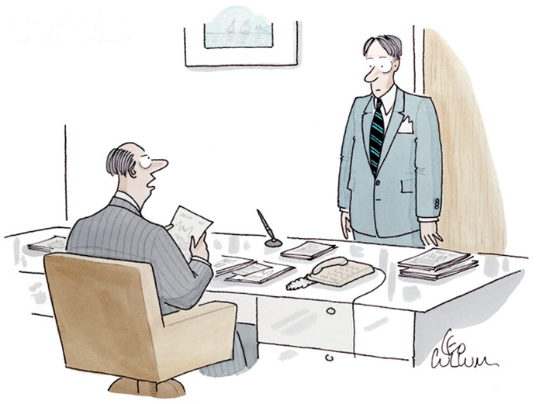
Who must the disclosure be made to? Tier 1
In most situations, it will need to be made to the employer (other body/hotline designated by the employer) to be protected

Slide 22
Anyone else? Tier 2
It can also be made to:
A “responsible person” (if the worker reasonably believes the relevant failure relates solely/mainly to the conduct of that responsible person or a matter which is the legal responsibility of that person and not the employer)
A government minister (where the worker is employed by an individual or a body appointed under any enactment including a statute or statutory instrument)
A legal adviser (in the course of obtaining legal advice)

Slide 23
Anyone else? Tier 3 – The test gets harder
A disclosure can also be made to a prescribed person as named in any relevant order (e.g. FSA, HMRC, the Audit commission, Ofcom, the Health and Safety Executive) if the worker, in good faith, reasonably believes:
that the default lies within the remit of the prescribed person
that the information disclosed and any allegation contained in it are substantially true
Prior disclosure to the employer is not required

Slide 24
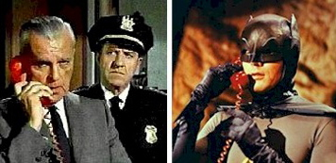
What about wider disclosure? Tier 4 - The test gets even harder…
A wider disclosure can be made e.g. to the police, the media, non-prescribed regulators etc where the following conditions are satisfied (in addition to good faith):
worker must reasonably believe that the information disclosed and any allegation contained in it are substantially true
worker must not make the disclosure for personal gain

Slide 25
What about wider disclosure? (continued)
unless the disclosure is exceptionally serious, the worker must have either:
previously disclosed substantially the same information to his employer or to a prescribed person OR
reasonably believe, at the time of the disclosure, that he will be subjected to a detriment by his employer if he makes the disclosure to his employer or a prescribed person OR
reasonably believe (where there is no prescribed person) that material evidence will be concealed or destroyed if the disclosure is made to his employer
it must be reasonable, in all the circumstances, for him to make the disclosure

Slide 26
Wider disclosure – when will it be reasonable in all the circumstances?
The tribunal will consider:
The identity of the person to whom disclosure is made
The seriousness of the default
Whether the default is ongoing or likely to continue in the future
Whether the disclosure was made in breach of a duty of confidentiality owed by the employer to a third party
Where previous disclosure has been made to the employer or a prescribed person what action was taken or might reasonably have been taken as a result
Where previous disclosure has been made to the employer, whether the worker complied with his employer’s whistleblowing policy

Slide 27
Exceptionally serious cases
Conditions for wider disclosure are slightly relaxed:
good faith
substantially true
no personal gain
reasonable in all the circumstances
Collins v National Trust

Slide 28
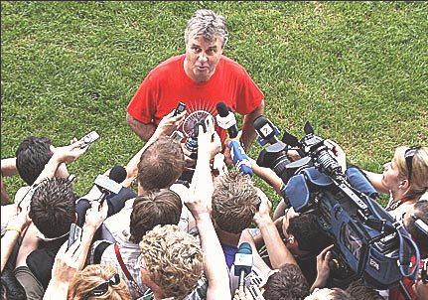
Disclosure to the media
Only protected in limited circumstances
Where a newspaper pays for a story, the worker is likely to fail the personal gain test and the good faith test

Slide 29
Passing details of claims to regulators
Since 6 April 2010, Tribunals have had the power to send details of whistleblowing claims directly to a prescribed person (e.g. a Regulator) where the claimant has consented
If consent is given and a notification is made to the relevant prescribed person, the respondent is notified accordingly
Initially significant concern that this would give undue bargaining power to claimants

Slide 30
The two main exceptions
Disclosure of legally privileged information by a person (e.g. a lawyer) to whom the information has been disclosed in the course of obtaining legal advice
Where the person making the disclosure commits a crime in so doing (e.g. a breach of the Official Secrets Act 1989)

Slide 31
Confidentiality
Contractual terms are void insofar as they purport to preclude the making of a protected disclosure
Even where the requirements for a protected disclosure are not made out, there may be a common law defence to breach of confidence if the information disclosed is sufficiently in the public interest

Slide 32
What should you do when someone blows the whistle during an internal or regulatory investigation?
Check the whistleblowing policy to see the appropriate procedure
Normally appropriate to initiate a separate investigation into the whistleblowing allegation
Ensure whistleblower is kept updated on that investigation as far as possible/appropriate
Ensure whistleblower is carefully handled at all times
Ensure confidentiality as far as possible

Slide 33
Compromising whistleblowing claims
In principle, it is possible for an employee to waive a dismissal or detriment claim
Need to bear in mind how a pay-off may be perceived by the regulator, or shareholders etc if the existence of the deal came into the public domain
Quantum of any pay-off will need to be justifiable

Slide 34
Rewards for whistleblowers
Rejected by Public Concern at Work
Parliamentary Commission on Banking Standards asked FCA and PRA to investigate
FCA and PRA worked with BIS and the Treasury and concluded (July 2014) that financial rewards would not increase disclosures

Slide 35
Rewards for whistleblowers (continued)
The US angle:
Bounty for bad behaviour – The Dodd-Frank Wall Street Reform and Consumer Protection Act in July 2010.
establishment of the Office of the Whistleblower
monetary awards to individuals who provide original information leading to successful enforcement action by the SEC leading to a recovery of at least $1 million.
Awards total between 10 to 30 percent of the monetary sanctions collected
Since its implementation, the SEC’s whistleblower reward program has paid out 17 awards, totalling more than $50 million

Slide 36
Rewards for whistleblowers (continued)
Recently 2 US agencies responsible for protecting whistleblowers have been found to retaliate against whistleblowers in their own companies

Slide 37
New rules on whistleblowing in financial institutions
The FCA published its policy statement (PS15/24) on “Whistleblowing in deposit-takers, PRA-designated investment firms and insurers” on 6 October 2015.
The PRA also issued Policy Statement PS24/15 and Supervisory Statement SS39/15.
New rules apply to “relevant firms” from 7 September 2016
“Whistleblowers’ champion” from 7 March 2016

Slide 38
Whistleblowing Statistics
In Autumn 2014, Freshfields commissioned Global Whistleblowing Report 2014 of more than 2,500 middle and senior-level managers across the US, UK, Hong Kong, Germany and France.
The report found that employees continue to fear reprisal for blowing the whistle.
More than one third (37%) of all employees surveyed believed senior management at their organisation would either treat them less favourably or look for ways to terminate their employment if they blew the whistle.
Four in every ten (40%) employees said their organisation discourages whistleblowing.

Slide 39
Whistleblowing statistics(continued)
The survey also revealed that:
64.4% would report a colleague if they suspected them of committing a criminal offence
More than 26% said they would go straight to a regulator if the wrongdoing wasn’t handled properly by the company
Regulators in the US, Hungary, Indonesia and South Korea offer financial rewards as an incentive to whistleblowers but only 9% said that financial incentives would trigger them to report suspected wrongdoing
40% said that paying whistleblowers could encourage false claims
44% say their companies don't have a whistleblowing policy or fail to publicise it

Slide 40
Any questions

Slide 41
Thank you
LON38302260

